Slide 1
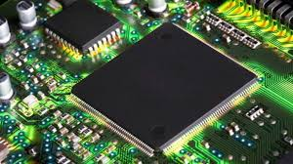
Unit-6
Stack & Subroutines
Prof. Swati Sharma
swati.sharma@darshan.ac.in
Microprocessor & Interfacing - 2150707 Darshan Institute of Engineering & Technology

Slide 2
Subject Overview
Sr. No. | Unit | % Weightage
1 | Introduction to Microprocessor | 8%
2 | Microprocessor Architecture and Operations | 7%
3 | 8085 Microprocessor | 10%
4 | Assembly Language Basics | 10%
5 | 8085 Assembly Language Programs | 10%
6 | Stack & Subroutines | 10%
7 | I/O Interfacing | 15%
8 | Advanced Microprocessors | 20%
9 | SUN SPARC Microprocessor | 5%
10 | ARM Processor | 5%

Slide 3
Stack
Stack is a group of memory location in the R/W memory that is used for temporary storage of binary information during execution of a program.
The starting memory location of the stack can be defined in program and space is reserved usually at the high end of memory map.
E.g.: LXI SP,FFF8; loads 16-bit memory address in stack pointer

Slide 4
Stack
Instruction necessary for stack are as follows:
LXI SP, 2095 | Load the stack pointer register with a 16-bit address.
PUSH B/D/H | It copies contents of register pair on the stack
PUSH PSW | Operand PSW represents Program status word meaning. i.e. content of accumulator and flags.
POP B/D/H | It copies content of top two memory locations of the stack in to specified register pair
POP PSW | It copies content of top two memory locations of the stack in to accumulator and flags respectively.

Slide 5
Subroutine
A subroutine is a group of instruction that performs a subtask of repeated occurrence.
A subroutine can be used repeatedly in different locations of the program.

Slide 6
Subroutine
Advantage of using Subroutine
Rather than repeat the same instructions several times, they can be grouped into a subroutine that is called from the different locations.
Where to write Subroutine?
In Assembly language, a subroutine can exist anywhere in the code.
However, it is customary to place subroutines separately from the main program.

Slide 7
Subroutine
The 8085 has two instructions for dealing with subroutines.
The CALL instruction is used to redirect program execution to the subroutine.
The RET instruction is used to return.

Slide 8
CALL Instruction
When CALL instruction is fetched, the microprocessor knows that the next two new Memory location contains 16-bit subroutine address.
Microprocessor reads subroutine address from the next two memory location and stores the higher order 8-bit of the address in the W register and stores the lower order 8bit of the address in the Z register.
Push the Older address of the instruction immediately following the CALL onto the stack [Return address].
Loads program counter(PC) with the new 16-bit address supplied with the CALL instruction from WZ registers.

Slide 9
Working of CALL Instruction
Before CALL instruction
CALL 4 0 5 0
4 0
5 0
Stack
03
06
06
Registers
2 1
W
Z
SP
5 0
SP
SP
PC
2 4
0 0

Slide 10
Subroutine
Working of CALL and RET instruction
Before CALL instruction
CALL 4 0 5 0
Stack
03
2151
06
06
2150
Registers
2 1
2149
W
4 0
5 0
Z
5 0
2148
2 4
2147
SP
0 0
2146
PC
2145
2144

Slide 11
Subroutine
Working of RET instruction
RET
Retrieve the return address from the top of the stack
Load the program counter with the return address.
Stack
03
2151
06
06
2150
Registers
2 1
2149
W
Z
SP
5 0
2148
SP
2 4
2147
SP
0 0
2146
PC
2145
2144

Slide 12
Subroutine
Things to be considered in Subroutine
Number of PUSH and POP instruction used in the subroutine must be same, otherwise, RET instruction will pick wrong value of the return address from the stack and program will fail.

Slide 13
Counters and Time Delays

Slide 14
Counters and Time Delays
Counters and Time Delays are important techniques.
Applications of Counters and Time Delays
They are commonly used in
Traffic Signal
Digital Clocks
Process Control
Serial data transfer

Slide 15
Counters and Time Delays
A counter is designed simply by loading appropriate number into one of the registers and using INR or DCR instructions.
Loop is established to update the count.
Each count is checked to determine whether it has reached final number ;if not, the loop is repeated.

Slide 16
Counters
How to create counters?
MVI C,05
LOOP: MOV A,C
OUT 01
DCR C
JNZ LOOP
HLT
Initialize
Display
Update
Is this Final Count
NO
YES
End

Slide 17
Counters
Label | Opcode | Operand | Comment | T-states
 | MVI | C,05h | ; Load Counter | 7
LOOP: | DCR | C | ; Decrement Counter | 4
 | JNZ | LOOP | ; Jump back to Decr. C | 10/7
MVI C, 05h
Machine Cycle: F + R = 2
T-States: 4T + 3T = 7T
DCR C
Machine Cycle: F = 1
T-States: = 4T
JNZ LOOP (true)
Machine Cycle: F + R + R =3
T-States: 4T + 3T + 3T=10T
JNZ LOOP (false)
Machine Cycle: F + R = 2
T-States: 4T + 3T =7T

Slide 18
Counters and Time Delays
Instruction MVI C, 05h requires 7 T-States to execute.
Assuming, 8085 Microprocessor with 2MHz clock frequency.
How much time it will take to execute above instruction?
Clock frequency of the system (f)= 2 MHz
Clock period (T) = 1/f = ½ * 10⁻⁶ = 0.5 μs
Time to execute MVI = 7 T-states * 0.5 μs
= 3.5 μs
How much time it will take to execute above instruction with 1 MHz clock frequency?

Slide 19
Counters and Time Delays
Label | Opcode | Operand | Comment | T-states
 | MVI | C,05h | ; Load Counter | 7
LOOP: | DCR | C | ; Decrement Counter | 4
 | JNZ | LOOP | ; Jump back to Decr. C | 10/7
Now to calculate time delay in loop, we must account for the T-states required for each instruction, and for the number of times instructions are executed in the loop.
The for the next two instructions:
DCR: 4 T-States
JNZ : 10 T-States
14 T-States
Here, the loop is repeated for 5 times.
+

Slide 20
Counters and Time Delays
How to calculate time delay for given loop?
Time delay in loop T_{L} with 2MHz clock frequency is calculated as:
T_{L}= T * Loop T-states * N₁₀ -----------------(1)
T_{L} : Time Delay in Loop
T : Clock Period
N₁₀ : Equivalent decimal number of hexadecimal count loaded in the delay register
Substituting value in equation (1)
T_{L}= (0.5 * 10⁻⁶ * 14 * 5)
= 35 μs

Slide 21
Counters and Time Delays
If we want to calculate delay more accurately, we need to accurately calculate execution of JNZ instruction
i.e
If JNZ = true, then T-States = 10
Else if JNZ =false, then T-States = 7

Slide 22
Counters and Time Delays
Now, according to our program:
Therefore, there is difference of (10T – 7T) 3T-states:
MVI C,05
LOOP: DCR C
JNZ LOOP
HLT
Here, the last cycle will be executed in 7 T-States;
when JNZ = false

Slide 23
Counters and Time Delays
Therefore, there is difference of (10T – 7T) 3T-states:
Delay generated by last clock cycle:
= 3T * Clock Period
= 3T * (1/2 * 10⁻⁶ )
= 1.5 μs
Now, the accurate loop delay is:
T_{LA}=T_{L} - Delay generated by last clock cycle
= 35 μs - 1.5 μs
= 33.5 μs
T_{L}= (0.5 * 10⁻⁶ * 14 * 5)= 35 μs

Slide 24
Counters and Time Delays
Now, to calculate total time delay
Total Delay = Time taken to execute instruction outside loop
+
Time taken to execute loop instructions
T_{D} = T_{O} + T_{LA}
= (7 * 0.5 μs) + 33.5 μs
= 3.5 μs + 33.5 μs
= 37 μs

Slide 25
Counters and Time Delays
Calculate time delay and accurate time delay for given loop with
Counter value =255 (FF h) and
Clock frequency =2MHz
T_{L}= T * Loop T-states * N₁₀ -----------------(1)
= 0.5 *10⁻⁶* 14* 255
= 1785 μs = 1.8 ms
T_{LA}= Time to execute loop instructions
= T_{L} – (3T states*clock period)
= 1785 – ( 3 * ½ * 10⁻⁶)
= 1785 – 1.5=1783.5 μs
Notes:
Time Delay in Loop TL= T*Loop T states * N10
= 0.5 * 14* 255
= 1785 μs = 1.8 ms

Slide 26
Exercise
How much time the 8085 microprocessor will take to execute the MOV B, A instruction, if the crystal frequency is 4MHz?
How much time will be required to execute the STAX B instruction if the clock frequency is 4 MHz?
How much time will be required to execute the MVI M,25h instruction if the clock frequency is 6 MHz?

Slide 27
Time Delay using a Register Pair
Time delay can be considerably increased by setting a loop and using a register pair with a 16-bit number (FFFF h).
A 16-bit is decremented by using DCX instruction.
Problem with DCX instruction
DCX instruction doesn’t set Zero flag.
Without test flag, Jump instruction can’t check desired conditions.
Additional technique must be used to set Zero flag.

Slide 28
Time Delay using a Register Pair
Label | Opcode | Operand | Comment | T-states
 | LXI | B,2384 h | ; Load BC with 16-bit counter | 10
LOOP: | DCX | B | ; Decrement BC by 1 | 6
 | MOV | A, C | ; Place contents of C in A | 4
 | ORA | B | ; OR B with C to chk Zero flag | 4
 | JNZ | LOOP | ; if result not equal to 0, 10/7 jump back to loop | 10/7
Here the loop includes four instructions:
Total T-States = 6T + 4T + 4T + 10T
= 24 T-states

Slide 29
Time Delay using a Register Pair
The loop is repeated for 2384 h times.
Converting (2384)₁₆ (_____)₁₀
2384 h = (2 * 16³ )+ (3* 16²) + (8 * 16¹) + (4 * 16⁰)
= 8192 + 768 + 128 + 4
= 9092
Clock frequency of the system (f)= 2 MHz
Clock period (T) = 1/f = ½ * 10⁻⁶ = 0.5 μs
9092

Slide 30
Time Delay using a Register Pair
Now, to find delay in the loop
T_{L}= T * Loop T-sates * N₁₀
= 0.5 *10⁻⁶* 24 * 9092
= 109104 μs
= 109 ms (without adjusting last cycle)

Slide 31
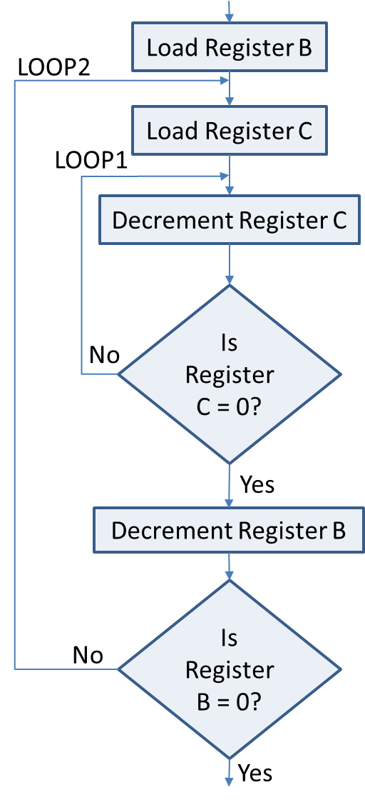
Time Delay using a LOOP within a LOOP
38 h
FF h
Label | Opcode | Operand | T-states
 | MVI | B,38h | 7T
LOOP2: | MVI | C,FFh | 7T
LOOP1: | DCR | C | 4T
 | JNZ | LOOP1 | 10/7 T
 | DCR | B | 4T
 | JNZ | LOOP2 | 10/7 T

Slide 32
Time Delay using a LOOP within a LOOP
Calculating delay of inner LOOP1: T_{L1}
LOOP1
Decrement Register C
Label | Opcode | Operand | T-states
LOOP1: | DCR | C | 4T
Is Register
C = 0?
 | JNZ | LOOP1 | 10/7 T
No
T_{L}= T * Loop T-states * N₁₀
= 0.5 *10⁻⁶* 14* 255
= 1785 μs = 1.8 ms
T_{L1}= TL – (3T states* clock period)
= 1785 – ( 3 * ½ * 10⁻⁶)
= 1785-1.5=1783.5 μs
Yes
Delay of Loop1 T_{L1}= 1783.5 μs

Slide 33
Time Delay using a LOOP within a LOOP
Now, Calculating delay of outer LOOP2: T_{L2}
MVI C, FF
Label | Opcode | Operand | T-states
 | MVI | B,38h | 7T
LOOP2: | MVI | C,FFh | 7T
TL₁ Delay in LOOP1
Delay of Loop1 T_{L1}= 1783.5 μs
 | DCR | B | 4T
 | JNZ | LOOP2 | 10/7 T
Counter B : (38)₁₆ = (56)₁₀
Loop2 is executed for 56 times
T-States = 7 + 4 + 10 = 21 T-States
T_{L2} = 56 (T_{L1} + 21 T-States * 0.5)
= 56( 1783.5 μs + 10.5)
= 100464 μs
T_{L2} = 100.46 ms
DCR B
JNZ LOOP2

Slide 34
Disadvantage of using software delay
Accuracy of time delay depends on the accuracy of system clock.
Microprocessor is occupied simply in a waiting loop; otherwise it could be employed to perform other functions.
The task of calculating accurate time delays is tedious.
In real time applications timers are commonly used.
Intel 8254 is a programmable timer chip, that can be interfaced with microprocessor to provide timing accuracy.
The disadvantage of using hardware chip include the additional expense and the need for extra chip in the system.

Slide 35
Counter design with time delay
Initialize Counter
Display
Load Delay Register
Time Delay
Decrement Delay Register
Update Count
No
Is Delay Register = 0?
Is Count
Complete?
No
Yes
Yes

Slide 36
Hexadecimal counter program
Write a program to count continuously in hexadecimal from FFh to 00h with 0.5 μs clock period. Use register C to set up 1ms delay between each count and display the number at one of the output port.
Given:
Counter= FF h
Clock Period T=0.5 μs
Total Delay = 1ms
Output:
To find value of delay counter

Slide 37
Hexadecimal counter program
Program
MVI B,FF
LOOP:MOV A,B
OUT 01
MVI C, COUNT; need to calculate delay count
DELAY: DCR C
JNZ DELAY
DCR B
JNZ LOOP
HLT

Slide 38
Hexadecimal counter program
Delay Calculations
MVI B,FF;
LOOP:MOV A,B
OUT 01
MVI C, COUNT
DELAY: DCR C
JNZ DELAY
DCR B
JNZ LOOP
HLT
Instruction | T-States
DCR C | 4
JNZ DELAY | 10
Total | 14 T
Calculate Delay for Internal Loop
T_{I} = T-States * Clock Period * COUNT
= 14 * 0.5 * 10⁻⁶ * COUNT
T_{I} = (7.0 * 10⁻⁶ )* COUNT

Slide 39
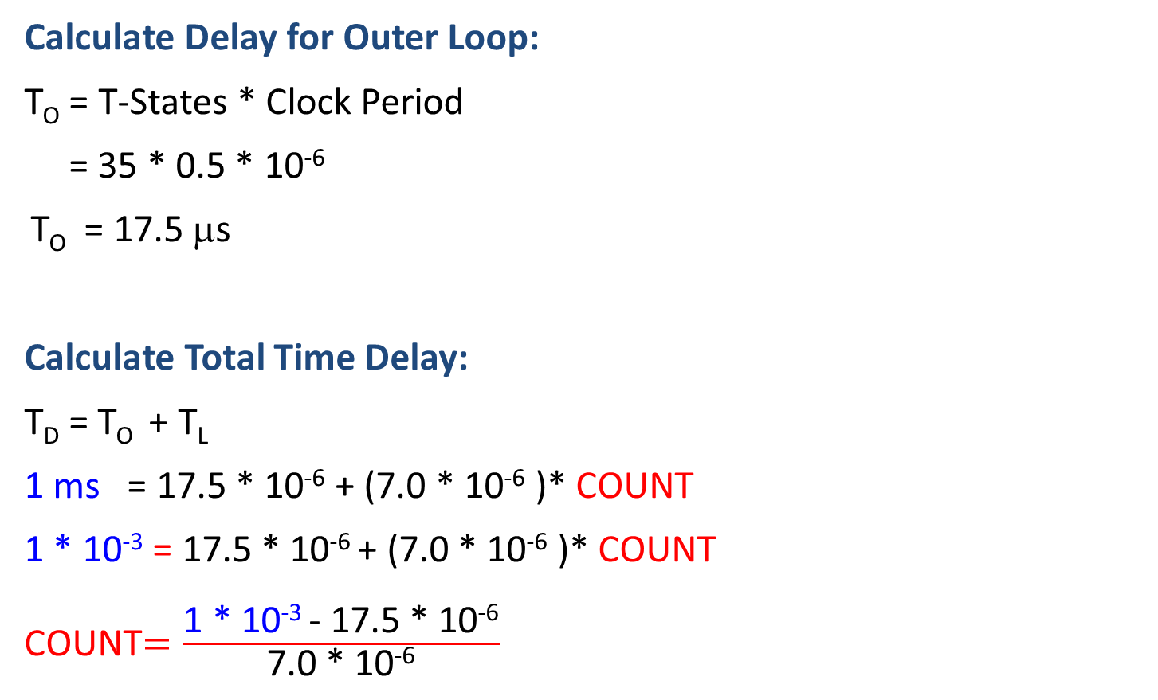
Hexadecimal counter program
Calculate Delay for Outer Loop:
T_{O} = T-States * Clock Period
= 35 * 0.5 * 10⁻⁶
T_{O} = 17.5 μs
Calculate Total Time Delay:
T_{D} = T_{O} + T_{L}
1 ms = 17.5 * 10⁻⁶ + (7.0 * 10⁻⁶ )* COUNT
1 * 10⁻³ = 17.5 * 10⁻⁶ + (7.0 * 10⁻⁶ )* COUNT
COUNT$=\frac{\text{1 ∗ 10}\text{−3} \text{− }\text{17.5 ∗ 10}\text{−6}}{\text{7.0 ∗ 10}\text{−6}}$
Instruction | T-States
MOV A,B | 4
OUT 01H | 10
MVI C, COUNT | 7
DCR B | 4
JNZ LOOP | 10
TOTAL | 35 T
≅ (140)₁₀ = (8C)₁₆

Slide 40
0-9 up/down counter program
Write an 8085 assembly language program to generate a decimal counter (which counts 0 to 9 continuously) with a one second delay in between. The counter should reset itself to zero and repeat continuously. Assume a Clock frequency of 1MHz.

Slide 41
0-9 up counter program
Program
START: MVI B,00H
DISPLAY: OUT 01
LXI H, COUNT
LOOP: DCX H
MOV A,L
ORA H
JNZ LOOP
INR B
MOV A,B
CPI 0A
JNZ DISPLAY
JZ START
Instruction | T-States
DCX | 6
MOV A,L | 4
ORA H | 4
JNZ | 10
TOTAL | 24 T

Slide 42
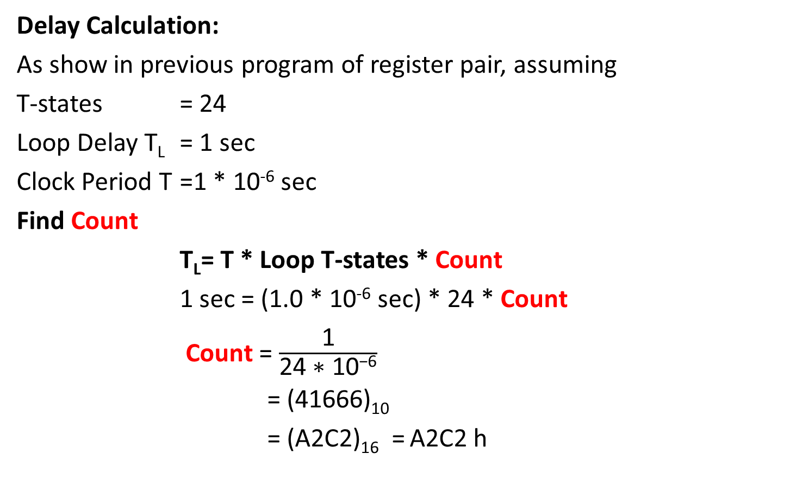
0-9 up counter program
Delay Calculation:
As show in previous program of register pair, assuming
T-states = 24
Loop Delay T_{L} = 1 sec
Clock Period T =1 * 10⁻⁶ sec
Find Count
T_{L}= T * Loop T-states * Count
1 sec = (1.0 * 10⁻⁶ sec) * 24 * Count
Count = $\frac{\text{1}}{\text{24 ∗ }\text{10}\text{−6}}$
= (41666)₁₀
= (A2C2)₁₆ = A2C2 h

Slide 43
Exercise
Calculate delay in following loop, assuming clock period = 0.33μs
TL= T * T-states * Count
Label | Instruction | T-states
 | LXI B, 12FF H | 10
DELAY: | DCX B | 6
 | XTHL | 16
 | XTHL | 16
 | NOP | 4
 | NOP | 4
 | MOV A,C | 4
 | ORA B | 4
 | JNZ DELAY | 10/7
Ans=102ms

Slide 44
Exercise
Write a set of 8085 assembly language instructions to generate a 1 second delay, if the crystal frequency is 6 MHz.
Note:
Clock Frequency(Operating Frequency)=Crystal Frequency/2
Clock Period = 1/Clock Frequency

Slide 45
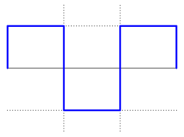
Square wave program
Write a program to generate a continuous square wave with the period of 500 μs with clock period of 325ns, and use bit D₀ to output square wave.
500 μs

Slide 46
Square wave program
Problem Analysis
In this problem, the period of square wave is 500 μs; therefore, the pulse should be ON(logic 1) for 250 μs and OFF(logic 0) for remaining 250 μs.
Therefore, the alternate pattern of 0/1 bits can be provided by loading Accumulator with AA h (1010 1010).
Now rotating the pattern once through each delay loop.
Bit D₀ of output port is used to provide logic 0 and 1.
The delay of 250μs can be easily obtained with an 8-bit delay count and one register.

Slide 47
Square wave program
Program
MVI D, AA
ROTATE: MOV A,D
RLC
MOV D,A
ANI 01
OUT 01
MVI B, COUNT
DELAY: DCR B
JNZ DELAY
JMP ROTATE
Logic 1
(A) 1 0 1 0 1 0 1 0
After RLC 0 1 0 1 0 1 0 1
ANI 01h 0 0 0 0 0 0 0 1
After AND 0 0 0 0 0 0 0 1
Logic 0
(A) 0 1 0 1 0 1 0 1
After RLC 1 0 1 0 1 0 1 0
ANI 01h 0 0 0 0 0 0 0 1
After AND 0 0 0 0 0 0 0 0

Slide 48
Square wave program
Delay Calculation:
In this problem, the pulse width is relatively small (250 μs); therefore, to obtain accurate output pulse, we should take into account for all the T-states.
The total delay should include the delay in the loop and execution time of the instruction outside the loop.

Slide 49
Square wave program
Delay Calculation:
No. of instruction outside the loop is seven.
Delay outside the loop T_{O}=46 T-states * 325 ns =14.95μs
Delay Loop includes two instruction, with 14 T-States, except for last cycle 11 T-States
Loop Delay T_{L}= 14 T * 325ns * (COUNT -1) + [ 11 T *325ns ]
T_{L} = 4.5 μs (COUNT -1) + 3.575 μs
Total delay required = 250 μs
T_{D} = T_{O} + T_{L}
250 μs = 14.95μs + 4.5 μs (COUNT -1) + 3.575 μs
Count = (52)₁₀
= (34)₁₆

Slide 50
Exercise
Write a program to generate a square wave with the period of 400μs with clock period of 325ns. Use bit D₀ to output square wave.
ANS = (42)₁₀

